Slide 1
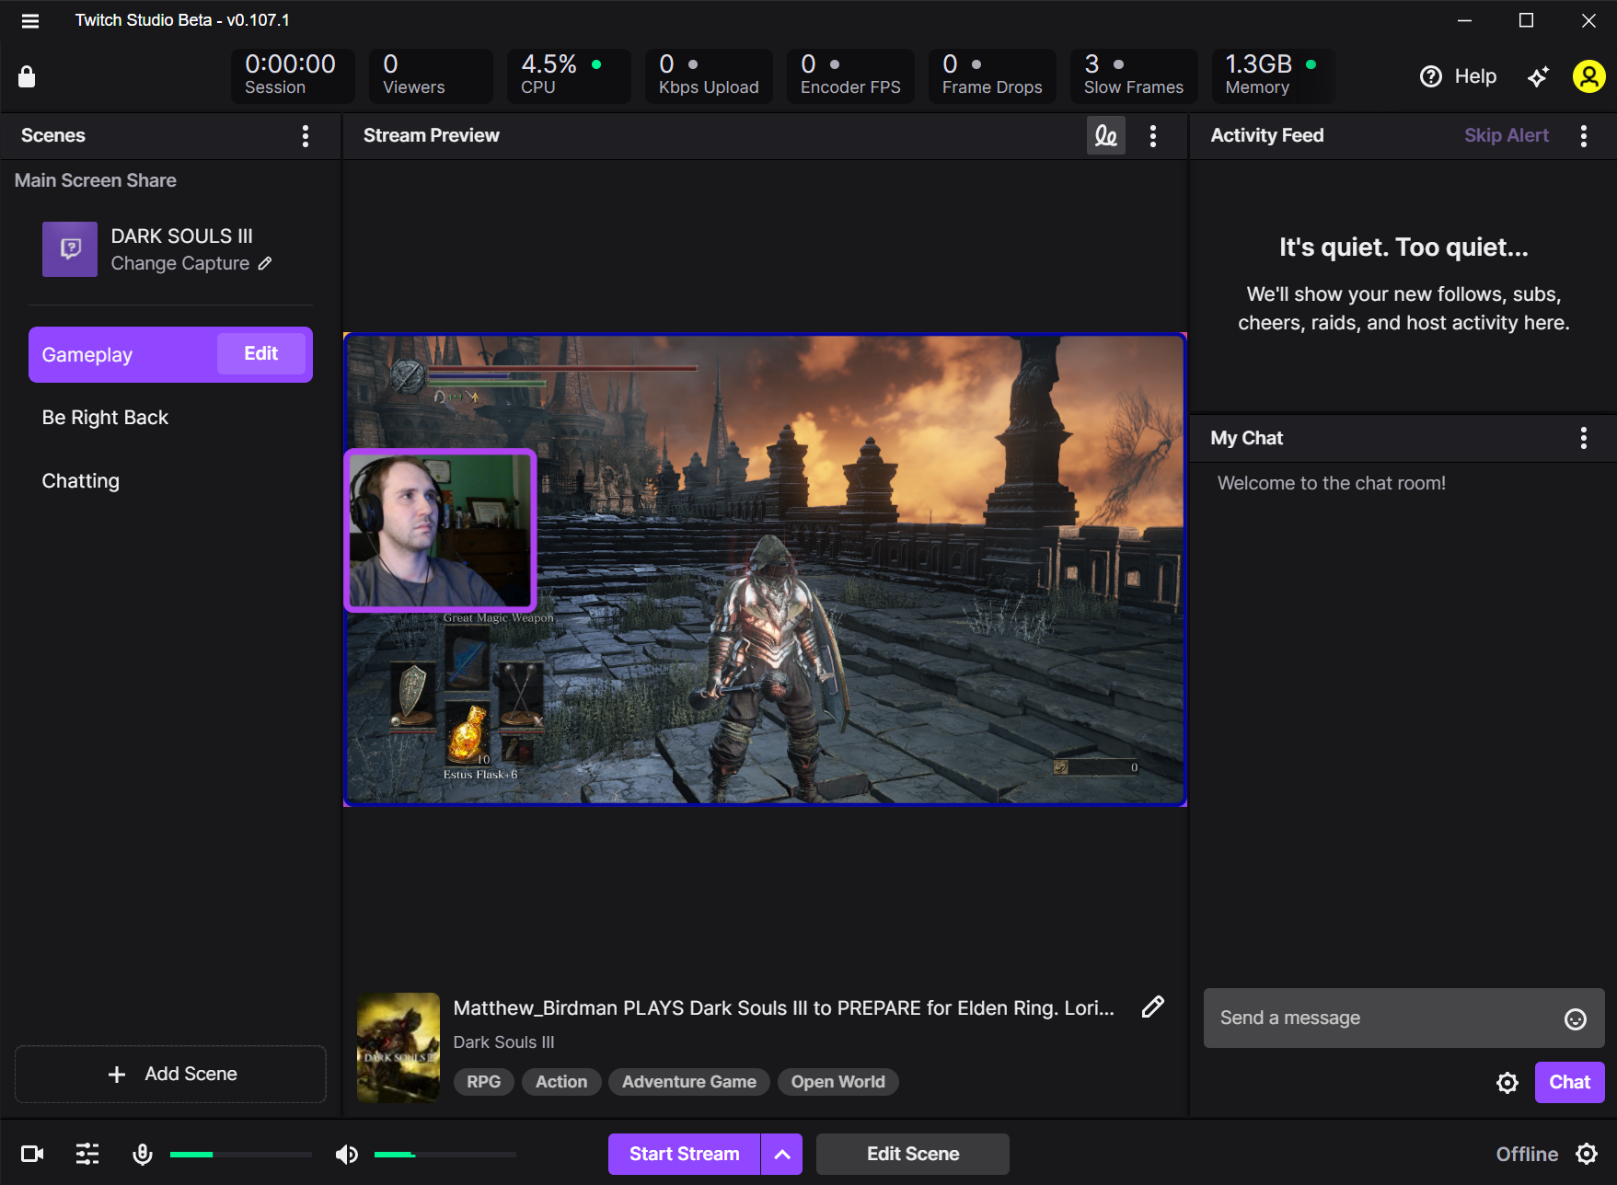
Welcome to your tour of Twitch Studio Beta

Slide 2
Your Stream
This is what your audience will see.

Slide 3
Settings
Adjust your stream settings here.

Slide 4
Scene
Choose your layout

Slide 5
Edit
Alter existing layouts

Slide 6
Add Scene
Add your own custom layout

Slide 7
Audio Mixer
Adjust your audio levels from your mic and content

Slide 8
Edit Scene
Alter your current layout

Slide 9
My Chat
You can view all comments from your audience here.

Slide 10
Start Stream
Click here when you are ready to start livestreaming

